Slide 1

Logistics Performance Analysis – Findings & Recommendations
Surya S B
24-Feb-2025

Slide 2

Introduction
Efficient pharmaceutical logistics is essential for the safe and timely delivery of medicines, vaccines, and medical supplies.
Given the stringent regulations and the delicate nature of these products, a well-managed supply chain is crucial to maintaining quality, ensuring compliance, and meeting patient needs.

Slide 3
Key Takeaways & Business Impact
Overall On-Time %: 77.2% (Goal: *90%)
Late Shipments: High in BE (Belgium) & CA (Canada)
Freight Costs:
Air shipments are expensive, but mostly on-time
Truck shipments are reliable and cheap
Forwarder Performance:
GFF 3 has highest On-Time and low freight cost.
GFF 5 has more Late shipments and have high freight cost.

Slide 4
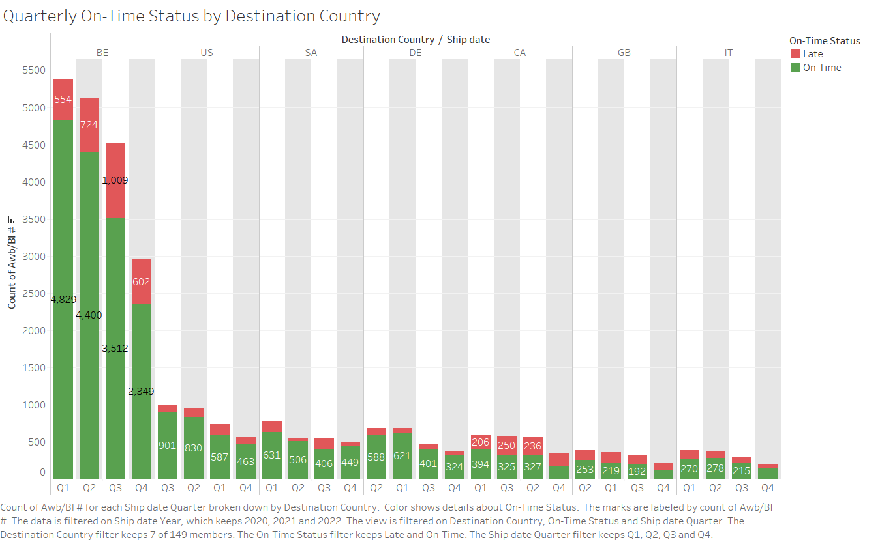
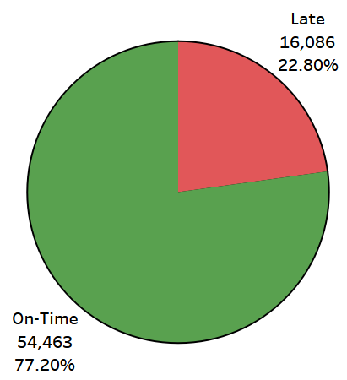
Shipment Performance by Country

Slide 5
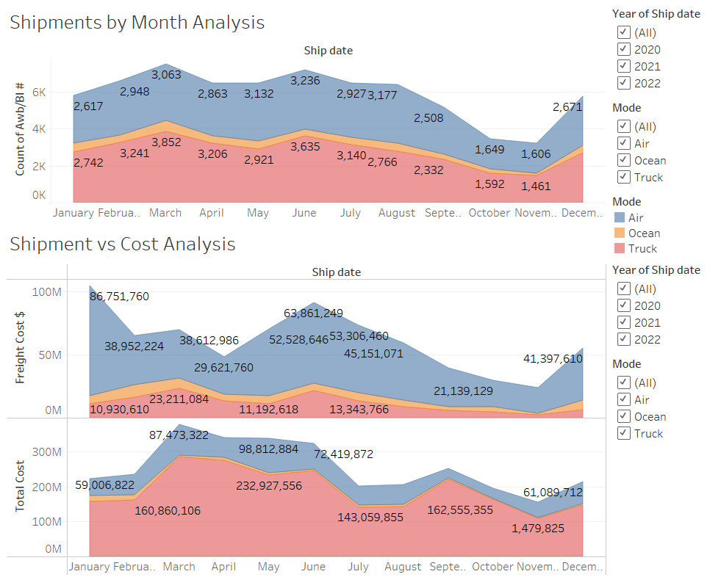

Slide 6
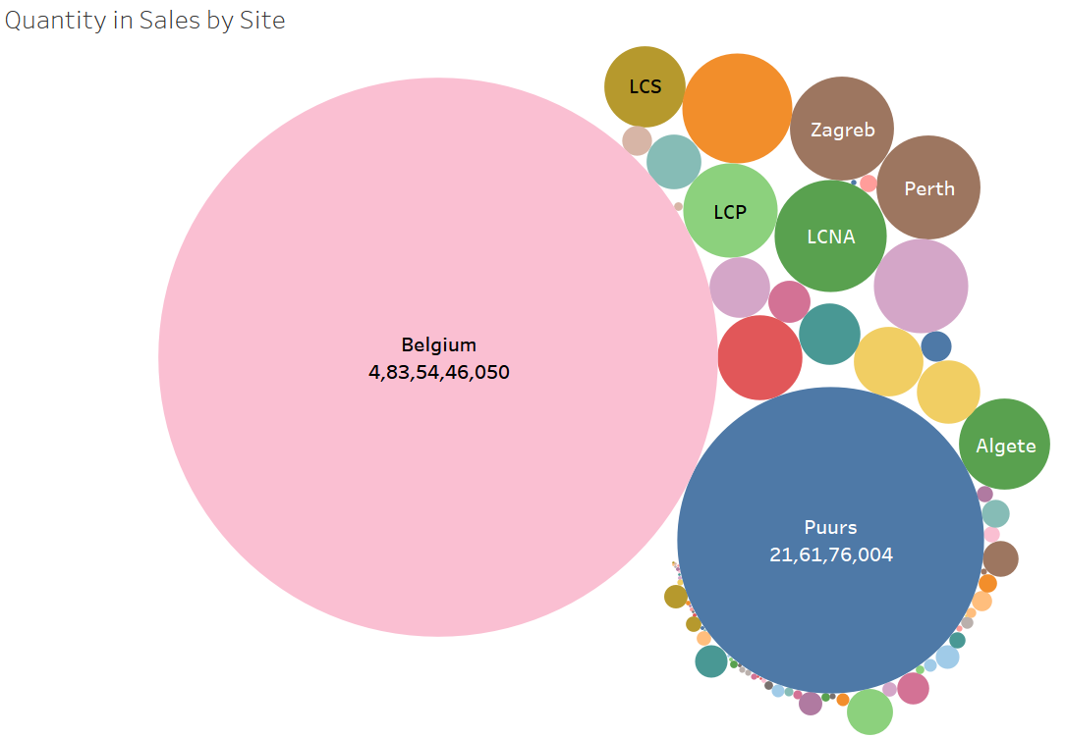

Slide 7
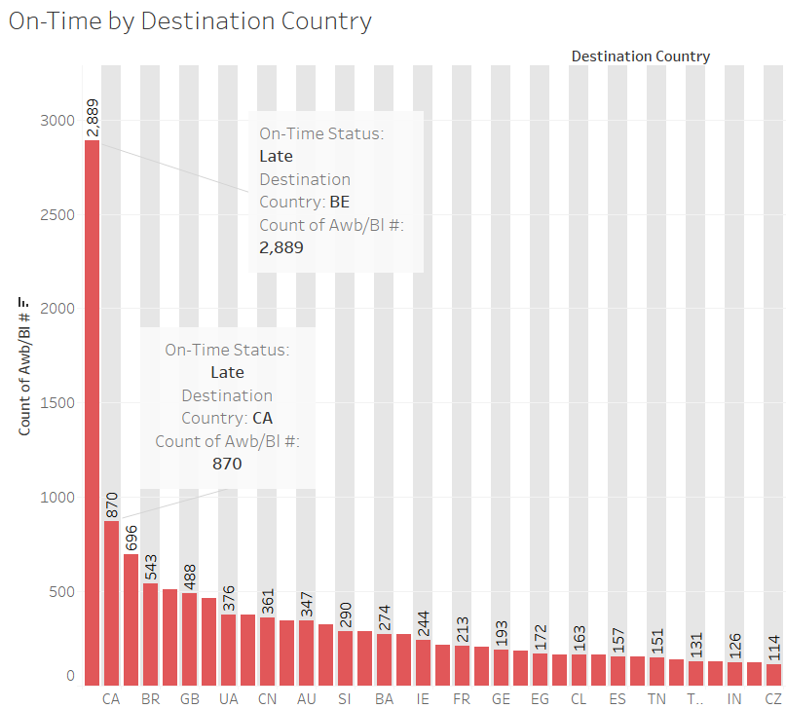
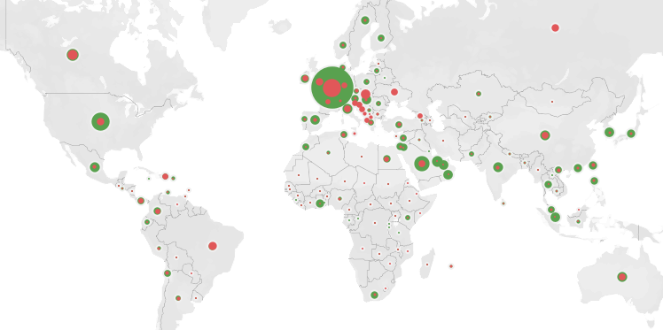
Shipment Performance by Country
Findings:
Belgium & Canada have the highest late shipments
Late shipments increased in Q3 for Belgium
Potential causes: Forwarder delays, customs, shipment mode

Slide 8
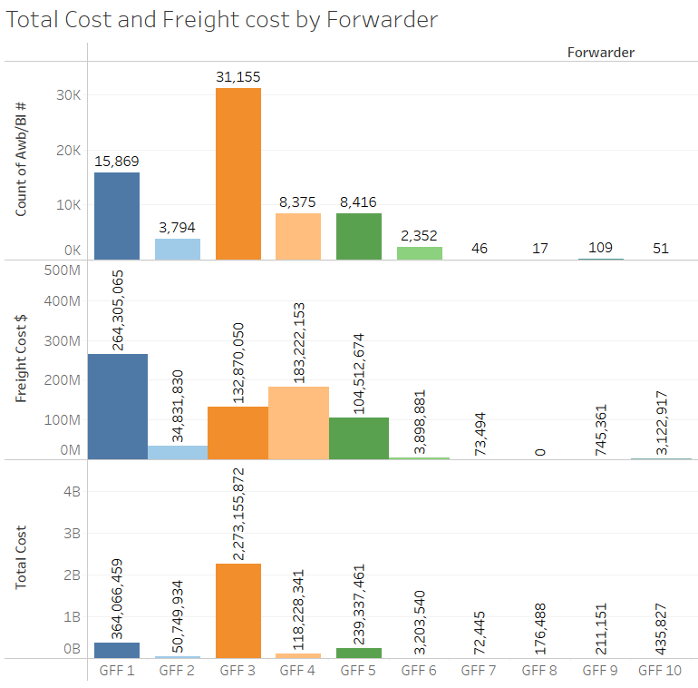
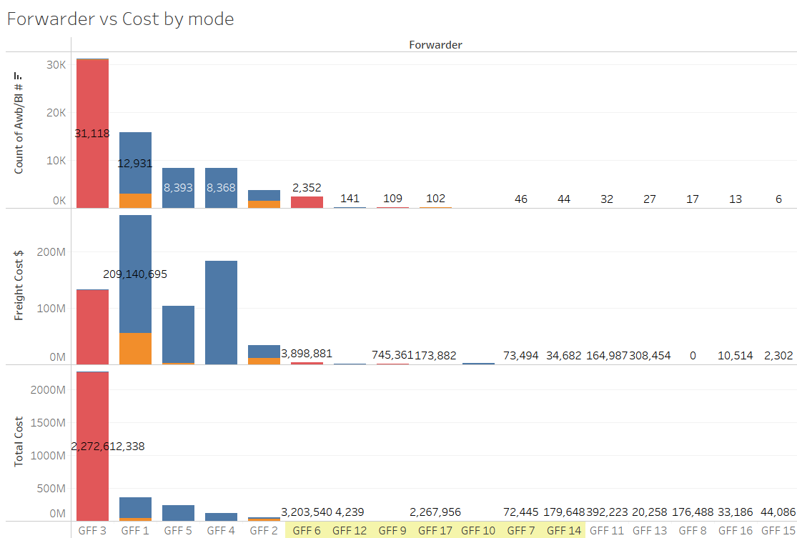

Are We Overpaying for Freight?

Slide 9
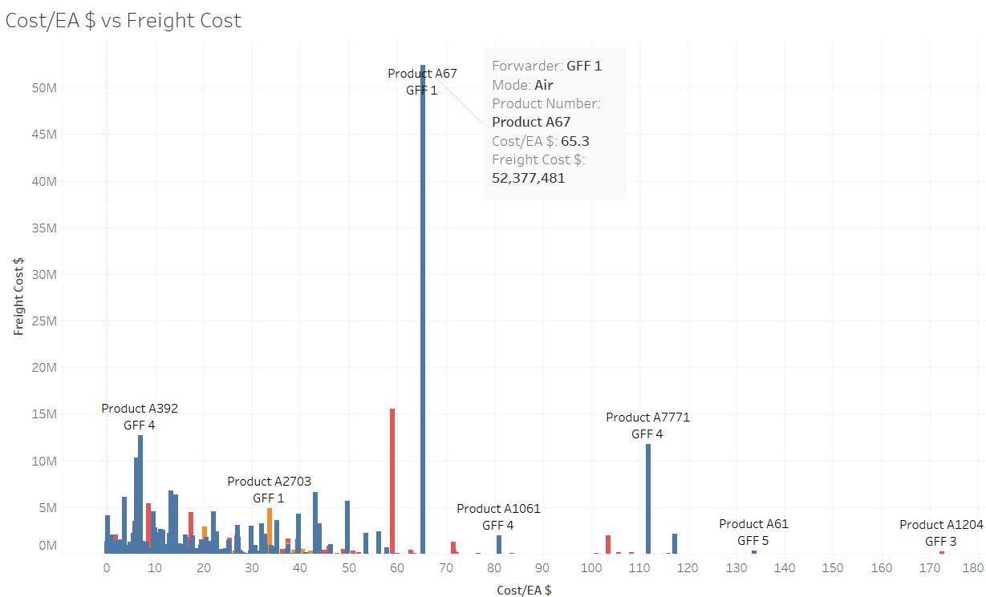
Are We Overpaying for Freight?
Findings:
Some low-cost products have very high freight costs
Air shipments are significantly more expensive.
High-cost shipments need cost optimization, try to move some products from Air shipments to Ocean or Truck.

Slide 10
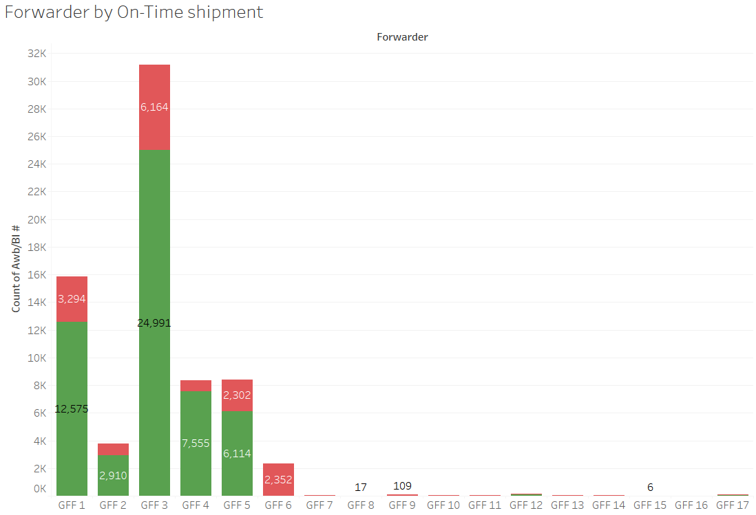

Which Forwarders Cause the Most Delays?
Findings:
GFF 2 has a 70% On-Time rate, impacting deliveries
GFF 3 (Truck shipments) is the most reliable (85% On-Time)
Air shipments are expensive but mostly on time, ship only high priority shipment via Air mode.

Slide 11
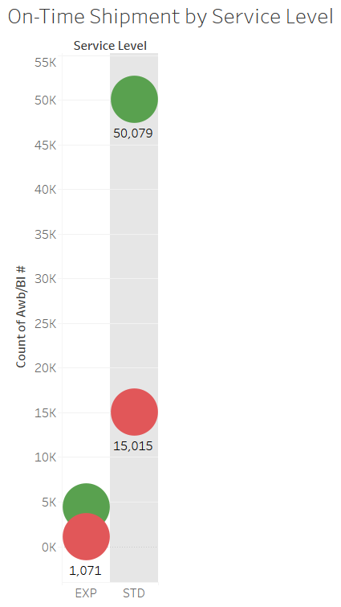
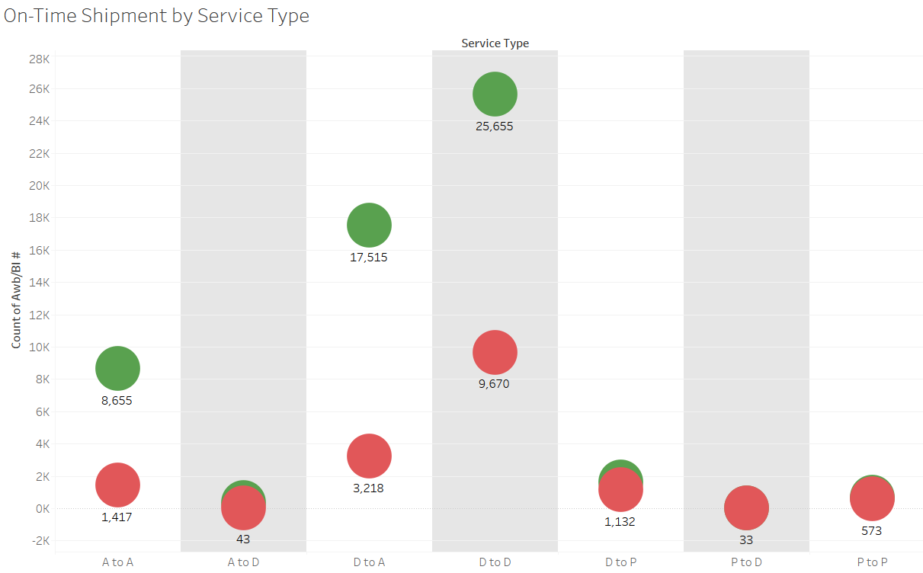

Slide 12
Optimizing Logistics for Better Performance
Reduce dependency on GFF 1 and GFF 4. Forwarder GFF3 is the most reliable.
Optimize shipment routes for Belgium & Canada.
Shift some air shipments to truck for Products like A67, A7771.
Improve shipment scheduling to avoid delays.
Automate tracking to flag delays early.

Slide 13
Final Takeaways & Discussion
1. Shipment Performance (On-Time vs Late)
Overall on-time delivery rate: 72%
Top-performing countries: Belgium, US, South Africa
Underperforming countries: Canada, Slovakia
Potential causes of delays: specific forwarders (GFF3, GFF1, GFF5), long-distance shipments
2. Product Cost vs Freight Cost Analysis
Some low-cost products have disproportionately high freight costs.
products such as A67, A7771 cost less but incur high shipping expenses → Potential cost-saving opportunities if we change the shipment mode or the forwarder.
3. Recommendations for Optimization
Improve on-time performance: Partner with better-performing forwarders, optimize routes.
Reduce freight cost inefficiencies: Negotiate better shipping rates, consolidate shipments.
Monitor forwarder performance: Switch to cost-effective and reliable logistics providers.

Slide 14
Thank you

